Slide 1
CS 1: Welcome and Introduction
CS 164: Java Programming
Colorado State University
Computer Science Department
Slides Originally Created by Albert Lionelle (Albert.Lionelle@colostate.edu)

Slide 2
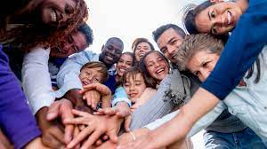
Who are you?
Grab a paper sheet, do a name tag and put it on your table ☺
Do it as soon as you see this!
Have it with you at the end of the class, you will use it in our next classes!

Slide 3
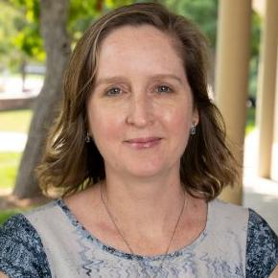
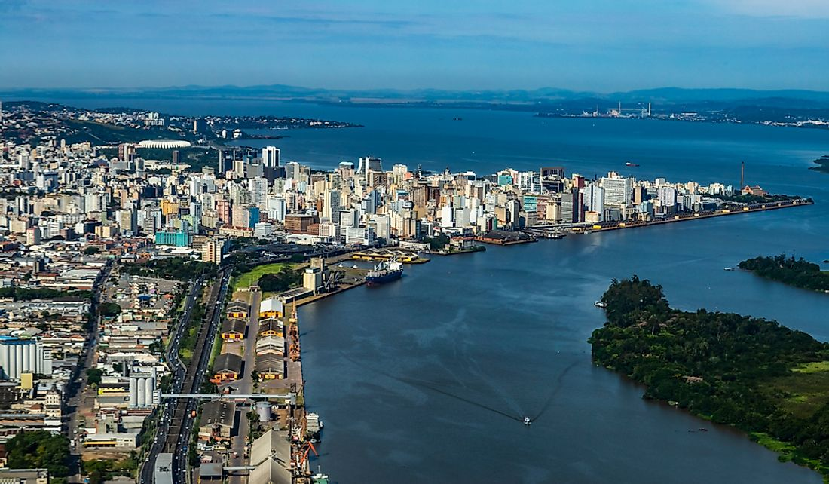
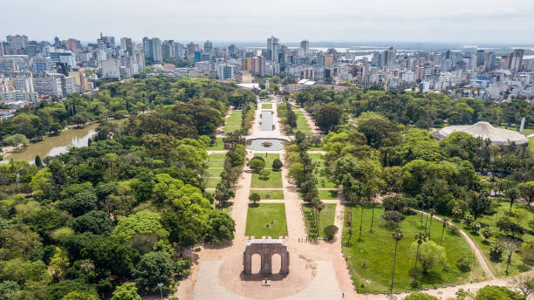

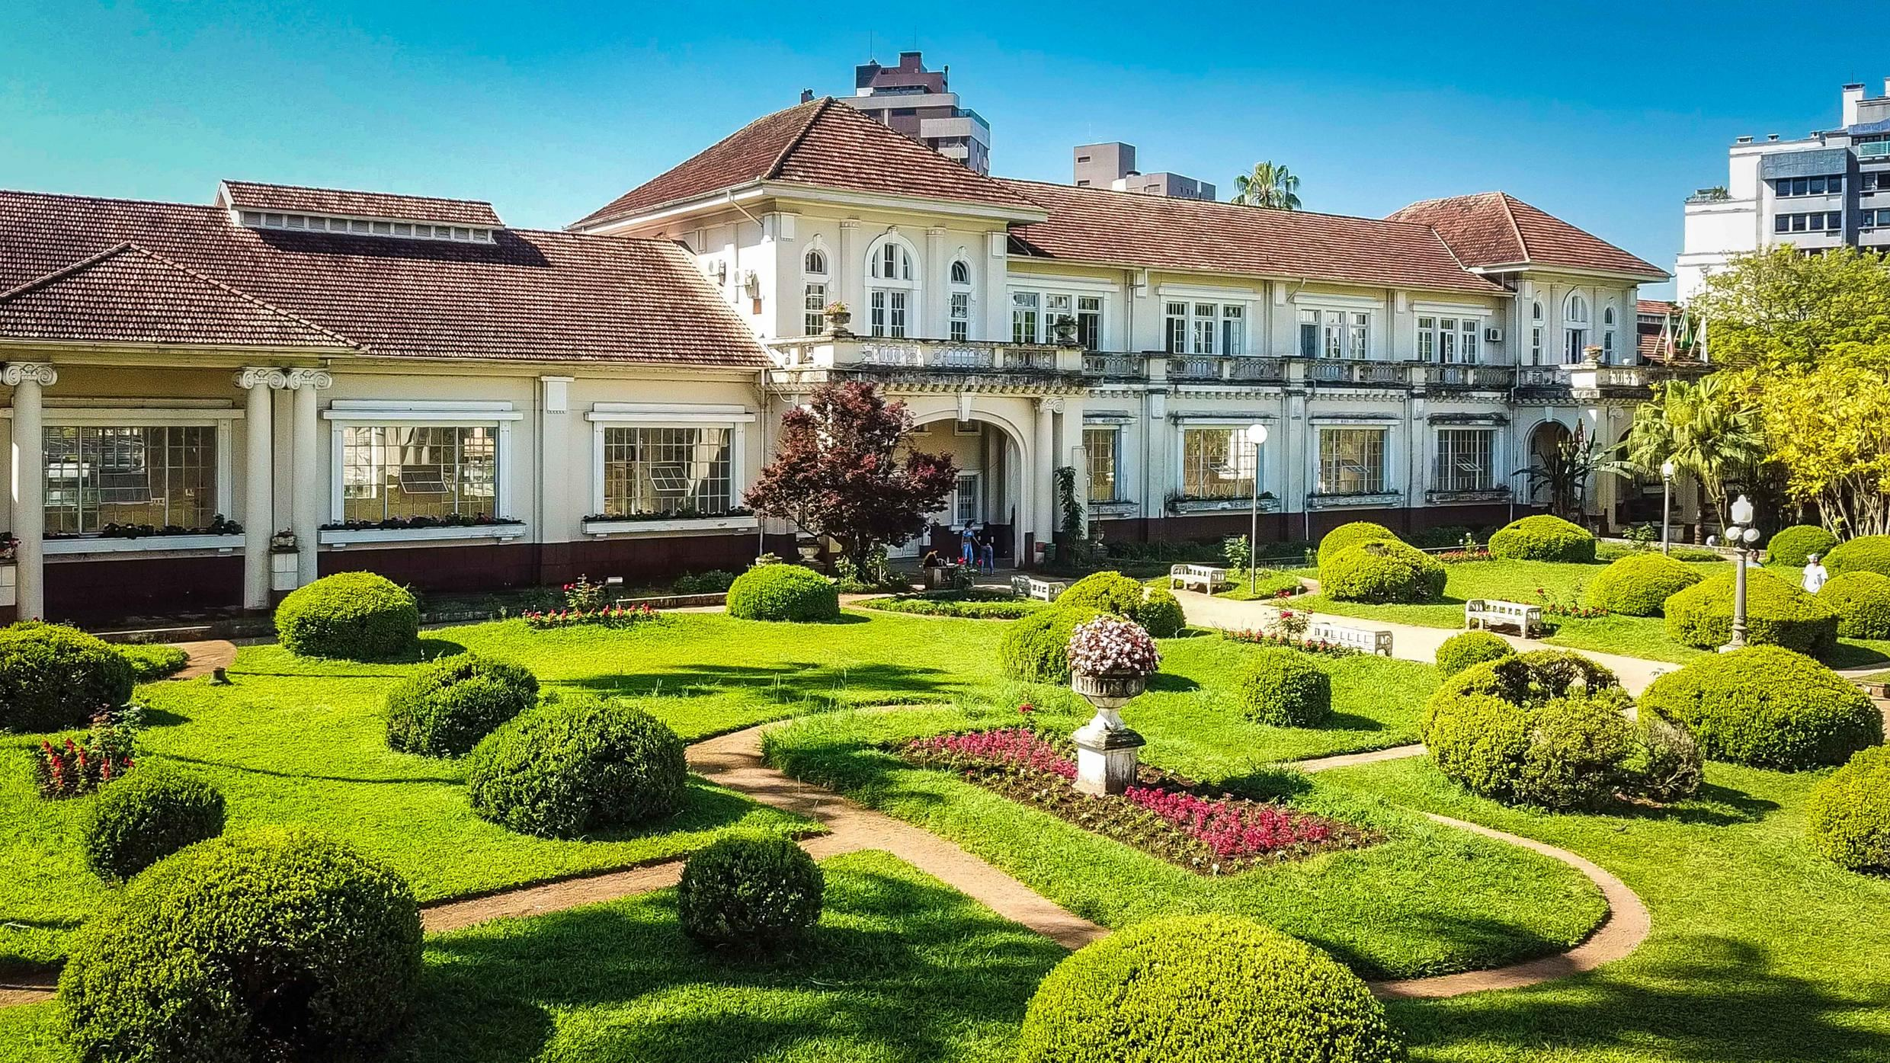
Who Am I?
PhD in Computer Science from Federal University of Rio Grande do Sul (UFRGS), Brazil
Artificial Intelligence applied to Education
PhD Student in Education Science working with Learning Analytics, School of Education, CSU
22 years of experience in Higher Education
Research Interests
Computer Science Education
Learning Analytics
Technology Enhanced Teaching and Learning
Outside Interests
Reading
Traveling with my family
Riding my bicycle

Slide 4
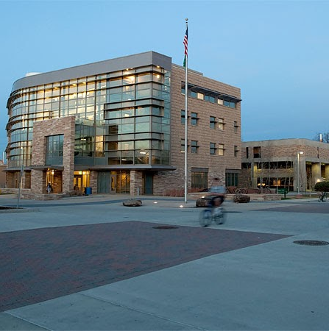
Instructor: How to Contact Me?
MS Teams Private Message
*BEST WAY*
email (poor), canvas (very bad!!)
General questions
Post in the general channel!
Let’s other see the answer
Check the Syllabus for Office Hours!
Mixed MS Teams and Office
stop by either but may need to wait.

Slide 5

Weekly Announcements!
Will have these up every week!
Start of every class as you come to class.
Always, always plan for readings to be done before class.
TODO Reminders:
Setup MS Teams
Reading 1 (Zybooks)
Syllabus Quiz
Python Review Exam
Knowledge Check – RPA 1

Slide 6
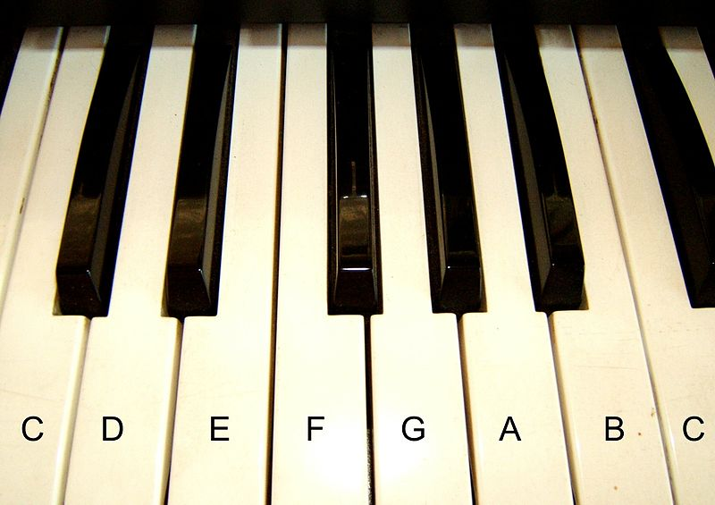


Topics Covered
Basic Java Programming
Variables
Control Structures (Branching)
Loops
Arrays
ArrayLists
Classes
Inheritance
Polymorphism
Essentially - learning the tool to build basic programs!
Problem Solving
Divide-Conquer-Glue
A way to look at the world
Like learning music - programming takes practice, practice, practice
Attribution: Algont
Computational Thinking:
Decomposition
Pattern Recognition
Abstraction
Algorithms

Slide 7
Teaching Approach/Concepts
Based on Psychology of Learning (4 week cycles)
Spacing
Interleaving
Practiced Recall
Elaboration
Reflection
Grading
Formative – Can be redone!
Summative – Demonstrate what you know
You are learning
A new language
A different way of thinking (Divide-Conquer-Glue)
OK to struggle!
To have another language is to possess a second soul. - Charlemagne (748 –814)

Slide 8
Course Structure - Follow Canvas
Readings
Due before Lectures - Sunday, Tuesday and Thursday nights
Lectures, Attendance, Worksheets
Active learning, a lot of group discussion and coding – BE HERE – or you will miss out.
Labs
Meant to be done after lecture content, due day assigned - coding/writing code
Knowledge Checks/Retrieval Practice Activities
Your best study tools
Exams
Canvas exams – reading content
Coding exams – writing content
Practical
These are large and hard programming assignments (usually 2 weeks), that bring it all together

Slide 9
Knowledge Checks/Retrieval Practice Activities
Focus on Reading Code
Also help with recall
Best thing to do – go back to them
Interleave – pick different orders to redo them from time to time
Spacing – do some every night!
Psychology of learning – this helps!
Best way to study for exams?
Every other night – knowledge checks, practice exam
Retesting + spacing
Highest result is the one kept
 | ReStudy | ReTesting
Massed
Spaced
Most
People
Ideal For
Recall

Slide 10
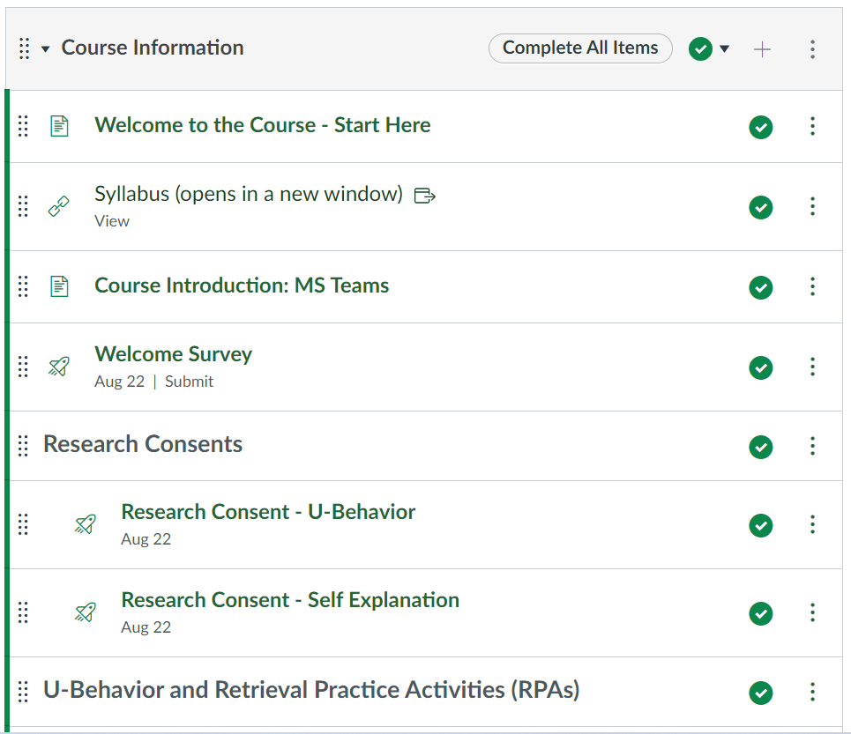
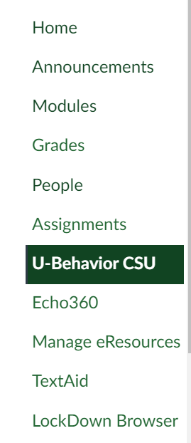
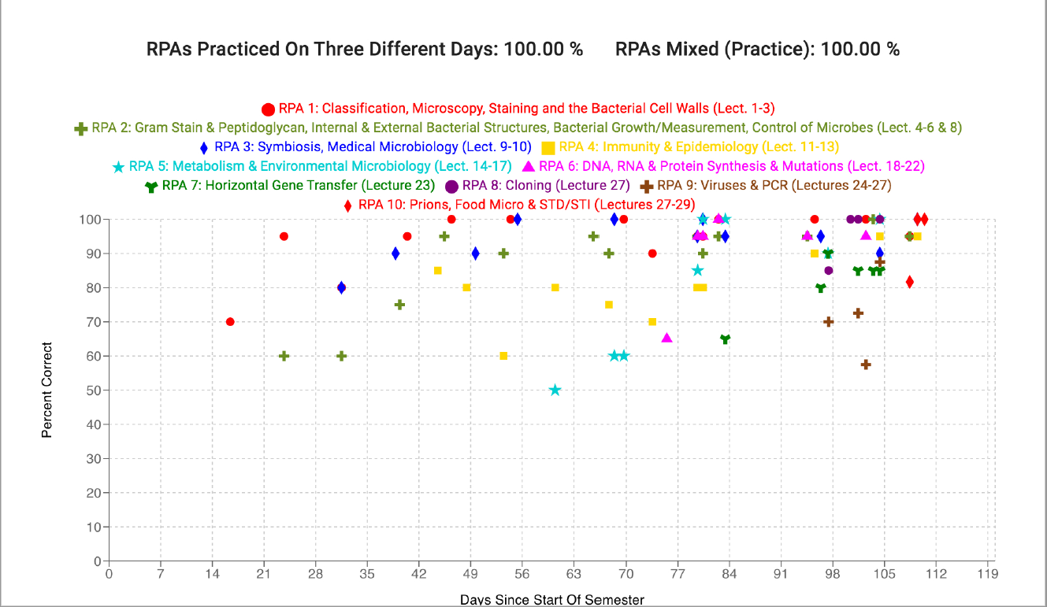
U-Behavior App and Research

Slide 11
Labs
Tuesday Labs
2 of 4 grade is based on activities / participation
Self-explanation in comments, drawing out graphs, writing tests
2 or 4 grade is based on submitted / auto graded (one is often just debugging)
All is meant to be done during lab.
Miss a lab, you need to coordinate with the lab TA.
Thursday Labs
Meant to building small programs
Can often take more than one day
Will have both provided code and your own code you write
4 of 4 is auto graded / based on working code.
Some of them *build* on each other, so you need past ones completed!

Slide 12
MS Teams!
MS Teams
Used in industry
We make use for the course (mixed with online and on-campus students)
Install the Application! (not just the browser)
Use the General Channel (Study Group!)
General Questions
Knowledge Checks
Reading
aka, any question that doesn’t require posting code *you* write

Slide 13
Asking For Help!
Starts the second week of classes
Help Desk – Office Hours (TA Code Review)
All hours are described here:
https://www.cs.colostate.edu/~cs163/.Fall23/#/
Office Hours/Student Hours – Marcia
W 8:00-9:00 am – CSB 456 and Teams
F 12:30-1:30 pm – CSB 456 and Teams
By appointment

Slide 14
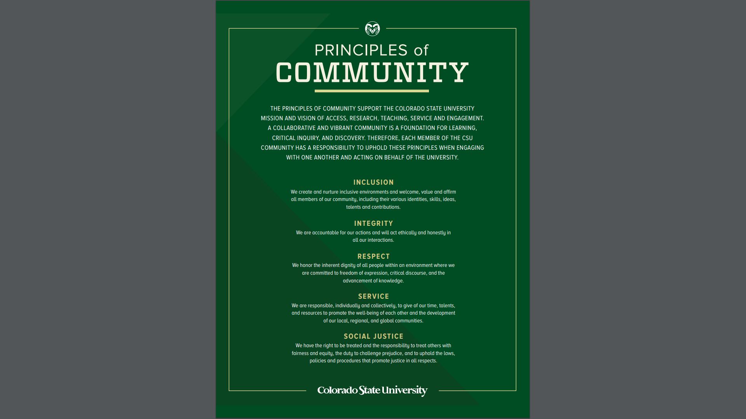
Expectation
Program copying will be monitored – don’t copy and/or share code!
Late submissions will not be accepted without document of illness, injury, or emergency
Help desk will show you how to debug and test your programs, they will not give you the code ☺
Lab scores will be based on completion

Slide 15
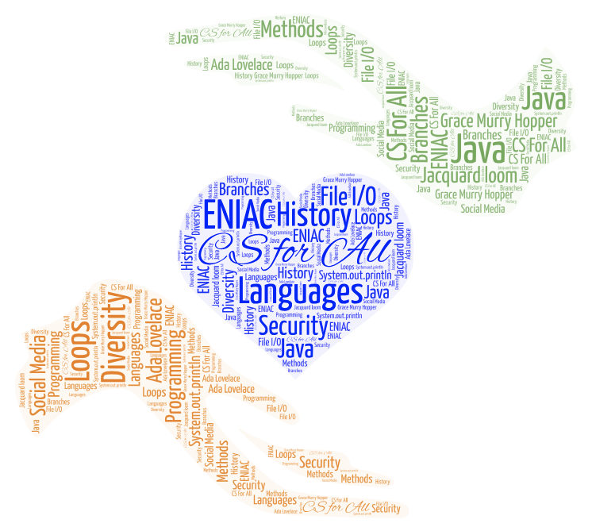
Coding is Like Music
To be successful in CS 164
Work on your schedule – don’t fall behind
Come to lectures
Go to your lab
Get help when you are stuck
Keep practicing
Memorization
Won’t help you!
You can’t memorize problem solving ☺
You have to practice Divide-Conquer-Glue

Slide 16
And who was the first programmer?
Talk with your peers/neighbors
Grab a paper
Write everyone names and their guesses (it could be “I don’t have any idea ☺”)
Do a web search to find an answer to that question
Write the first programmer’s name and at least one information that you found about them

Slide 17
And who was the first programmer?

Slide 18

The Right Honourable
Countess of Lovelace
Ada Lovelace (1815-1852)
English mathematician who worked with Charles Baggage on his Analytical Engine
In 1843 she translated an article written by the Italian mathematician and engineer Luigi Federico Menabrea, “Notions sur la machine analytique de Charles Babbage” and supplemented it with her own “Notes”
Her “Notes” contains what many consider to be the first computer program
Ability to connect the Arts and Science, she developed a vision of the capabilities of computers to go beyond calculation, it can do anything that can be noted in symbols, including words and music (https://www.britannica.com/biography/Ada-Lovelace/images-videos)
Ada Lovelace Day – second Tuesday in October
Photo By:
Alfred Edward Chalon [Public domain], via Wikimedia Commons

